Slide 1



Innovation Action proposal Deeply Programmable High-speed Data Planes
Dr. Sándor Laki – lakis@elte.hu
Eötvös Loránd University (ELTE), Budapest, Hungary

Slide 2
Business pain
Need for new networking features
By data centers, enterprise networks
For customizing and optimizing their networks
Currently, each new feature requires the switch software to be changed
Domain specific knowledge on ASIC programming
Takes years to introduce a simple features
Just think of VXLAN – 4 years to add it to ASICs
Very high development costs

Slide 3
Business opportunity
Multi-target Compiler for generating high-speed data plane programs
Quick development and deployment of new features
Easy to learn network function descriptions in P4 language
Significantly reduced switch programming costs
High-performance switch code can be generated automatically
Increased reusability
Hardware independent code can be reused
Re-targetability
Support of multiple network hardware (CPU, NPU, prog. ASICs,…)

Slide 4
Why now?
Technology Evolution
Optimize
for
flexibility
Optimize for performance
Inflection
point
Time
today

Slide 5
Why now?
These are the main drivers for SDN and NFV
meaning
more flexibility
easier and centralized control
(close to) generic, programmable hardware
but we don’t want to entirely sacrifice performance in this process!
Technology Evolution
Optimize
for
flexibility
P4 specification has just reached the maturity level needed for adaptation by production ready switches
Optimize for performance
Inflection
point
Time
today

Slide 6
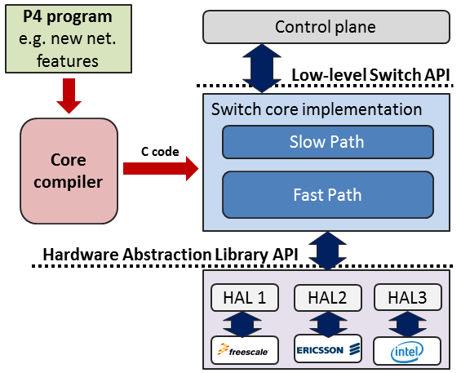
What we have
ELTE P4C An experimental multi-target P4 compiler
Open source (see http://p4.elte.hu)
Network functions described in P4-14 (P4-16 is coming soon)
Multi-target support (Core + Hardware Abstraction Library)
Currently supported architectures: Intel, Freescale, OpenWRT
Generates high-speed data plane program
demo at ACM SIGCOMM’16
ELTE is a member of P4 consortium
P4.org – over 60 members

Slide 7
What we have
ELTE P4C An experimental multi-target P4 compiler

Slide 8
Format of activity
Format:
tech transfer or startup creation
Technology maturation & experimentation
Integration into existing SDN ecosystems e.g. OpenDaylight, OpenStack, etc.
Supporting additional switching hardware Flexible Match+Action ASICs
Performance improvement HW-based optimization (e.g. Intel DPDK extensions)
Business model & Business launch
Open-source business model; Business use cases
Go-to-market strategy is needed
Business champion: Ericsson or startup to be created
Customers: Ericsson RadioGW, data center operators, telecom operators

Slide 9
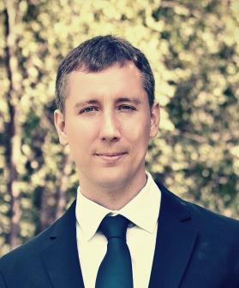
Contact Info
Main contact:
Dr. Sándor Laki, ELTE E-mail: lakis@elte.hu
More details and demos: http://p4.elte.hu/
Current partners:
Ericsson Research Hungary (committed)
Intel (on going discussion)

