Slide 1
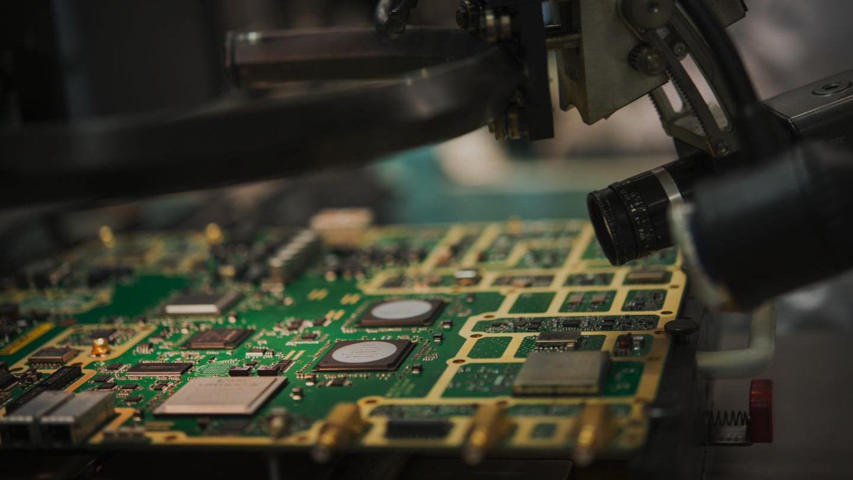
p4 over odp solution, results and comparison to a different approach
Gergely Pongrácz
Ericsson Research
Notes:
3/8/20172010-12-10
1

Slide 2
Performance vs. Flexibility
Technology Evolution
These are the main drivers for SDN and NFV
meaning
more flexibility
easier and centralized control
(close to) generic, programmable hardware
but we don’t want to entirely sacrifice performance
in this process!
Optimize for
flexibility
Optimize for performance
Inflection
point
today
Time
Inspired by Vinod Khosla @ ONS2014

Slide 3
the role for p4 and odp
Domain Specific Languages (e.g. P4)
  intentionally limited language
    easier for “average” developers
    better overall performance
    less “generic” errors (e.g. memory mgmt, locks)
    better for hardware vendors
  good tradeoff between high performance and flexibility
Open Data Plane (ODP)
  main goal is portability
  defines “good enough” abstraction for most networking tasks
  implementation quality depends on vendor support
    functionality
    packet handling performance
    scalability, etc.

Slide 4
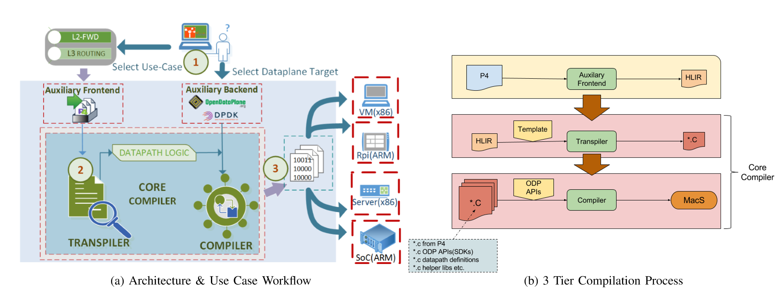
the p4/odp (macsad*) architecture
*MACSAD = Multi-Architecture Compiler System for Abstract Dataplanes

Slide 5
Multi-target Compiler (ELTE)
1. Hardware-independent „Core”
  P4 HLIR is used to generate the Intermediate Representation (IR)
  Our core compiler compiles the IR to a hardware independent C code with HAL API calls
2. Hardware-dependent „HAL”
  Implementing a well defined API that fulfills the requirements of most hardwares
  A static and thin library implementing networking primitives for a given target
  Written by a hardware expert
3. Switch program
  Compiled from the hardware-independent C code of the „Core” and the target-specific HAL
  Resulting in a hardware dependent switch program
P4 HLIR
Core compiler
C compiler & linker
P4 program
Intermediate
Representation
„Core” code using HAL API calls
Switch program
HAL implementation for a given target

Slide 6
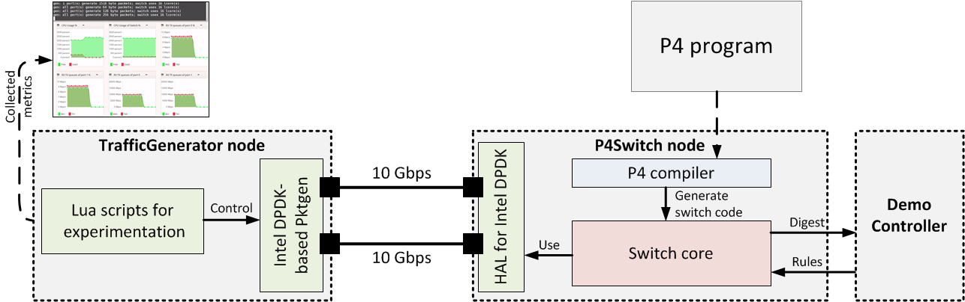
Evaluation setup
Evaluation scenarios
1 x 10 Gbps test traffic
(14.88 Mpps)
2 x 10 Gbps test traffic
(29.76 Mpps)
TrafficGenerator and P4Switch nodes
  Intel XEON E5-2630 6 cores, 12 threads, @ 2.3GHz, 2x8 GB DDR3 SDRAM
  Dual 10 Gbps NIC (Intel 82599ES)
  NFPA tool for automated tests with PktGen

Slide 7
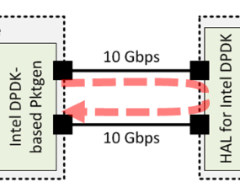
L2 forwarding
Two lookup tables
  SMAC & DMAC
  Exact maches only
Generating digests
  For unseen SMACs
Demo controller fills tables SMAC and DMAC according to the digest received
1 x 10 Gbps TX rate

Slide 8
L3 routing
Simple L3 example
Three lookup tables
  IPv4_lpm, nexthops, send_frame
  LPM and exact matches
Demo controller fills tables in advance
1 x 10 Gbps TX rate

Slide 9
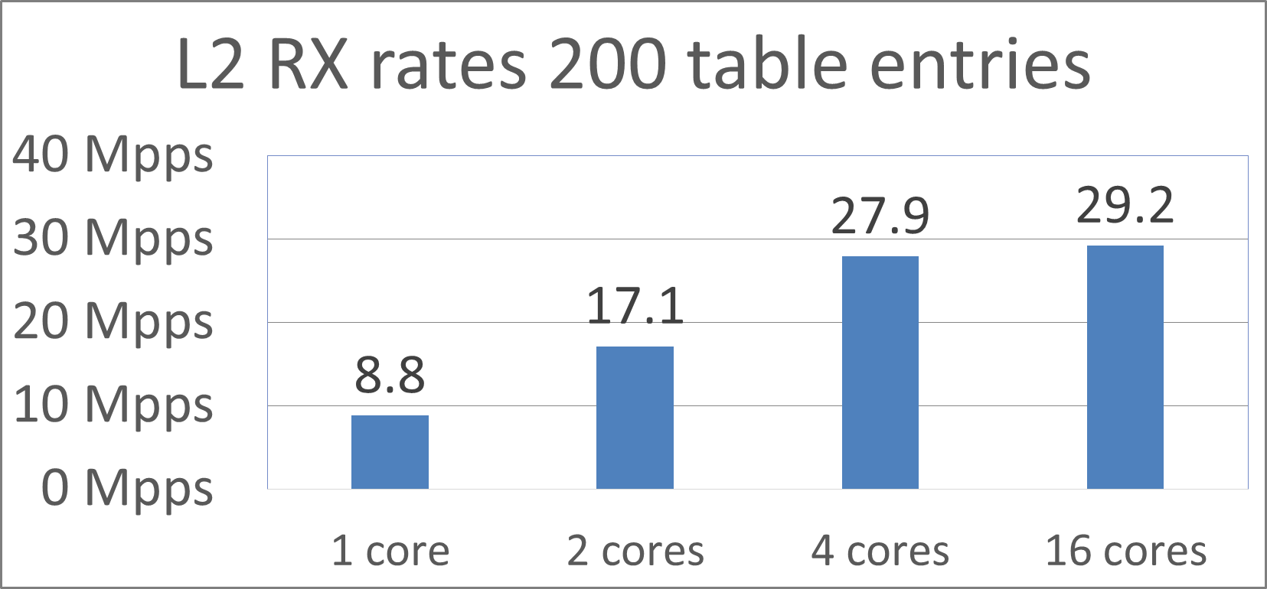
some more results
P4/DPDK has a Freescale LS2085 (ARM) variant
  good L2 performance: ~2.5 Mpps per core, ~18 Mpps per board
  other use cases are under test
P4/DPDK scales well until hitting interface limit
P4/ODP has a BananaPi (ARM) variant
  not built for high-performance, but proves easy portability
P4/ODP is compiled to Cavium ThunderX
  high-end ARM-based network processor with 48 cores and high-perf buses
  first results are coming soon
P4/ODP has a Netmap based backend as well
  performance is almost identical to DPDK on x86
results from SigComm 2016 demo

Slide 10

Summary and next steps
P4 pipelines can achieve line rate with 1 core and real-life packet size mix in simple use cases (L2, L3)
Direct P4/DPDK pipeline outperforms P4/ODP and is close to reference examples (OpenFlow, DPDK examples)
  but there are some low hanging fruits for optimize the P4/ODP pipeline, e.g. zero-copy I/O
ODP without DPDK is not suitable for high performance on x86
Next steps
  define and implement more use cases with both backends: e.g. VxLAN, BNG, mobile gateway
  more performance debugging and optimizations on P4/ODP
  scalability tests and comparisons to P4/DPDK
  try non-x86 high-end hardware (Cavium ThunderX) to prove portability and check performance
  publish results to a high-end conference, e.g. IEEE HPSR

Slide 11




p4 project members
Unicamp FEEC (P4/ODP)
  Christian E. Rothenberg
  Gyanesh Patra
  Juan S. Mejia
  Fabricio R. Cesen
  Javier R. Q. Ancieta
Ericsson Research
  Gergely Pongrácz
  Zoltán Kiss
ELTE (P4/DPDK)
  Software Lab
    Máté Tejfel
    Dániel Horpácsi
    Dániel Leskó
    Róbert Kitlei
  CNL
    Sándor Laki
    Péter Vörös

Slide 12
references
P. G. Patra, C. E. Rothenberg, and G. Pongrácz, “MACSAD: MultiArchitecture Compiler System for Abstract Dataplanes (Aka Partnering P4 with ODP),” in ACM SIGCOMM’16 Demo and Poster Session, 2016.
S. Laki, D. Horpácsi, P. Vörös, R. Kitlei, D. Leskó, and M. Tejfel, “High speed packet forwarding compiled from protocol independent data plane speciﬁcations,” in ACM SIGCOMM’16 Demo and Poster Session, 2016.
L. Csikor et al, “NFPA: Network function performance analyzer,” in IEEE NFV-SDN, 2015.
GIT links:
  P4/DPDK: https://github.com/P4ELTE/t4p4s
  P4/ODP: https://github.com/intrig-unicamp/mac

Slide 13
thank you! questions, comments?

