Slide 1



Innovation Action proposal
Deeply Programmable
High-speed Data Planes
Dr. Sándor Laki – lakis@elte.hu
Eötvös Loránd University (ELTE), Budapest, Hungary

Slide 2
What’s the problem – market situation
Need for new networking features
  By data centers, enterprise networks
  For customizing and optimizing their networks
Currently, each new feature requires the switch software to be changed
  Domain specific knowledge on ASIC programming
  Takes years to introduce a simple features
    Just think of VXLAN – 4 years to add it to ASICs
Very high development costs

Slide 3
What’s the market opportunity:
Multi-target Compiler
for generating high-speed data plane programs
  Quick development and deployment of new features
    Easy to learn network function descriptions in P4 language
  Significantly reduced switch programming costs
    High-performance switch code can be generated automatically
  Increased reusability
    Hardware independent code can be reused
  Re-targetability
    Support of multiple network hardware (CPU, NPU, prog. ASICs,…)

Slide 4
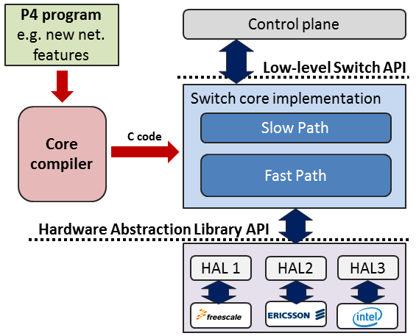
What we have
ELTE P4C
An experimental multi-target P4 compiler
Open source (see http://p4.elte.hu)
Network functions described in P4-14 (P4-16 is coming soon)
Multi-target support (Core + Hardware Abstraction Library)
  Currently supported architectures: Intel, Freescale, OpenWRT
Generates high-speed data plane program
  demo at ACM SIGCOMM’16
ELTE is a member of P4 consortium
      P4.org – over 60 members

Slide 5
What we need
Technology maturation & experimentation
  Integration into existing SDN ecosystems
  e.g. OpenDaylight, OpenStack, etc.
  Supporting additional switching hardware
  Flexible Match+Action ASICs
  Performance improvement
  HW-based optimization (e.g. Intel DPDK extensions)
Business model & Business launch
  Open-source business model; Business use cases
  Go-to-market strategy is needed
  Business champion – partner or startup, spin-off
  Customers (hw vendor, cloud provider or telco) are needed

Slide 6

Contact Info
Main contact:
Dr. Sándor Laki, ELTE
E-mail: lakis@elte.hu
More details and demos: http://p4.elte.hu/
Current partners:
Ericsson Research Hungary (committed)
Intel (on going discussion)

